Slide 1

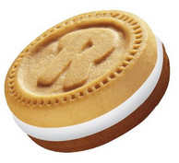
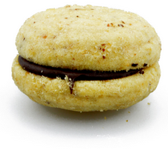

Cookies
Not these ones…

Slide 2
Using Cookies in PHP
A cookie is an item of data that a web server saves to your computer’s hard disk via a web browser.
It can contain almost any alphanumeric information (as long as it’s under 4 KB) and can be retrieved from your computer and returned to the server.
Common uses include:
Session tracking
Maintaining data across multiple visits
Holding shopping cart contents
Storing login details, and more.

Slide 3
Using Cookies in PHP
Because of their privacy implications, cookies can be read only from the issuing domain.
In other words, if a cookie is issued by, for example, sjsu.edu, it can be retrieved only by a web server using that domain. This prevents other websites from gaining access to details for which they are not authorized.
Because of the way the Internet works, multiple elements on a web page can be embedded from multiple domains, each of which can issue its own cookies.
When this happens, they are referred to as third-party cookies. Most commonly, these are created by advertising companies in order to track users across multiple websites.
Notes:
Because of this, most browsers allow users to turn cookies off either for the current server’s domain, third-party servers, or both.
Fortunately, most people who disable cookies do so only for third-party websites.

Slide 4
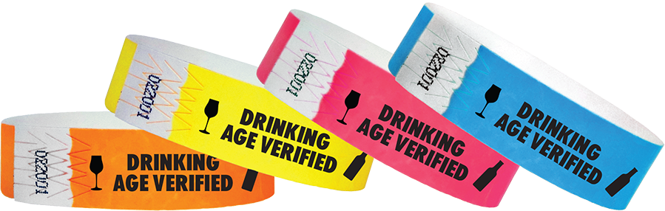
Cookie authorization/authentication analogy

Slide 5
Example attack to Chrome
Most people approach:
You, an intellectual:
Get victim password
Using Remote Debugging
<running code on your computer>
Get Chrome safe storage password
Ask nicely for cookies
Decrypt cookies with password
Chrome cookies stolen

Slide 6

Using Cookies in PHP
Cookies are exchanged during the transfer of headers, before the actual HTML of a web page is sent, and it is impossible to send a cookie once any HTML has been transferred.
Therefore, careful planning of cookie usage is important.

Slide 7
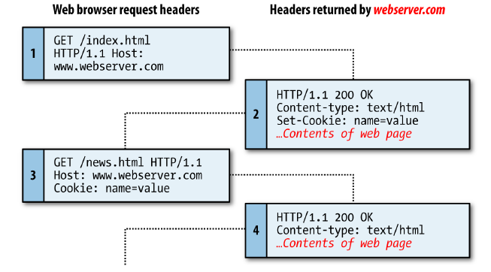
This figure illustrates a typical request and response dialog between a web browser and web server passing cookies.

Slide 8
The browser issues a request to retrieve the main page, index.html, at the website http://www.webserver.com
The first header specifies the file, and the second header specifies the server.

Slide 9
When the web server at webserver.com receives this pair of headers, it returns some of its own.
The second header defines the type of content to be sent (text/html), and the third one sends a cookie of the name name and with the value value. Only then are the contents of the web page transferred.

Slide 10
New page requested
Once the browser has received the cookie, it will then return it with every future request made to the issuing server until the cookie expires or is deleted.
So, when the browser requests the new page /news.html, it also returns the cookie name with the value value

Slide 11
Because the cookie has already been set, when the server receives the request to send /news.html, it does not have to resend the cookie, but just returns the requested page.

Slide 12
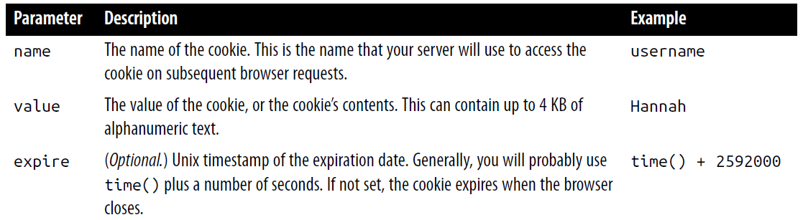
Setting a Cookie
Setting a cookie in PHP is a simple matter. As long as no HTML has yet been transferred, you can call the setcookie function, which has the following syntax:
setcookie(name, value, expire, path, domain, secure, httponly);

Slide 13
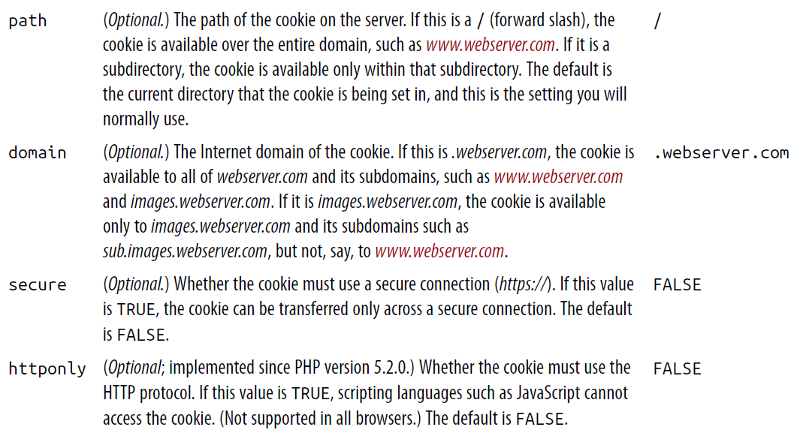
setcookie(name, value, expire, path, domain, secure, httponly);

Slide 14
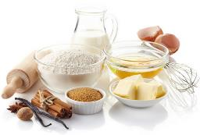
Setting a Cookie
So, to create a cookie with
name username
value Hannah
accessible across the entire web server on the current domain
removed from the browser’s cache in seven days
use the following ingredients:
setcookie('username', 'Hannah', time() + 60 * 60 * 24 * 7, '/');
setcookie(name, value, expire, path, domain, secure, httponly);

Slide 15

Accessing a Cookie
Reading the value of a cookie is as simple as accessing the $_COOKIE system array.
For example, if you wish to see whether the current browser has the cookie called username already stored and, if so, to read its value, use the following:
if (isset($_COOKIE['username']))
$username = $_COOKIE['username’];
Note that you can read a cookie back only after it has been sent to a web browser.
This means that when you issue a cookie, you cannot read it in again until the browser reloads the page (or another with access to the cookie) from your website and passes the cookie back to the server in the process.

Slide 16

Destroying a Cookie
To delete a cookie, you must issue it again and set a date in the past.
It is important for all parameters in your new setcookie call except the timestamp to be identical to the parameters when the cookie was first issued; otherwise, the deletion will fail.
setcookie('username', 'Hannah', time() - 2592000, '/’);
As long as the time given is in the past, the cookie should be deleted. However, I have used a time of 2,592,000 seconds (one month) in the past in case the client computer’s date and time are not correctly set.

Slide 17
HTTP Authentication
HTTP authentication uses the web server to manage users and passwords for the application.
It’s adequate for most applications that ask users to log in, although some applications have specialized needs or more stringent security requirements that call for other techniques.
To use HTTP authentication, PHP sends a header request asking to start an authentication dialog with the browser.
The server must have this feature turned on in order for it to work, but because it’s so common, your server is likely to offer the feature.
Notes:
Although it is usually installed with Apache, HTTP authentication may not necessarily be installed on the server you use.
So attempting to run these examples may generate an error telling you that the feature is not enabled, in which case you must install the module, change the configuration file to load the module, or ask your system administrator to do these fixes.

Slide 18
HTTP Authentication
After entering your URL into the browser or visiting via a link, the user will see an “Authentication Required” pop up, requesting two fields:
User Name and Password

Slide 19
<?php
if (isset($_SERVER['PHP_AUTH_USER']) &&
isset($_SERVER['PHP_AUTH_PW']))
{
echo "Welcome User: " . $_SERVER['PHP_AUTH_USER'] .
" Password: " . $_SERVER['PHP_AUTH_PW’];
}
else
{
header('WWW-Authenticate: Basic realm="Restricted Section“’);
header('HTTP/1.0 401 Unauthorized’);
die("Please enter your username and password");
}

Slide 20
<?php
if (isset($_SERVER['PHP_AUTH_USER']) &&
isset($_SERVER['PHP_AUTH_PW']))
{
echo "Welcome User: " . $_SERVER['PHP_AUTH_USER'] .
" Password: " . $_SERVER['PHP_AUTH_PW’];
}
else
{
header('WWW-Authenticate: Basic realm="Restricted Section“’);
header('HTTP/1.0 401 Unauthorized’);
die("Please enter your username and password");
}
?>
The first thing the program does is look for two particular array values:
$_SERVER['PHP_AUTH_USER'] and $_SERVER['PHP_AUTH_PW’]
If they both exist, they represent the username and password entered by a user into an authentication prompt.

Slide 21
<?php
if (isset($_SERVER['PHP_AUTH_USER']) &&
isset($_SERVER['PHP_AUTH_PW']))
{
echo "Welcome User: " . $_SERVER['PHP_AUTH_USER'] .
" Password: " . $_SERVER['PHP_AUTH_PW’];
}
else
{
header('WWW-Authenticate: Basic realm="Restricted Section“’);
header('HTTP/1.0 401 Unauthorized’);
die("Please enter your username and password");
}
?>
If either value does not exist, the user has not yet been authenticated and you display the prompt by issuing the following header, where Basic realm is the name of the section that is protected and appears as part of the pop-up prompt:
WWW-Authenticate: Basic realm="Restricted Area"

Slide 22
If the user fills out the fields, the PHP program runs again from the top.
But if the user clicks the Cancel button, the program proceeds to the following two lines, which send the following header and an error message:
HTTP/1.0 401 Unauthorized
The die statement causes the text “Please enter your username and password” to be displayed
<?php
if (isset($_SERVER['PHP_AUTH_USER']) &&
isset($_SERVER['PHP_AUTH_PW']))
{
echo "Welcome User: " . $_SERVER['PHP_AUTH_USER'] .
" Password: " . $_SERVER['PHP_AUTH_PW’];
}
else
{
header('WWW-Authenticate: Basic realm="Restricted Section“’);
header('HTTP/1.0 401 Unauthorized’);
die("Please enter your username and password");
}
?>

Slide 23
HTTP Authentication
Once a user has been authenticated, you will not be able to get the authentication dialog to pop up again unless the user closes and reopens all browser windows, as the web browser will keep returning the same username and password to PHP.

Slide 24
<?php
$username = 'admin’; // Our set credentials…
$password = 'letmein’;
if (isset($_SERVER['PHP_AUTH_USER']) && isset($_SERVER['PHP_AUTH_PW']))
{
if ($_SERVER['PHP_AUTH_USER'] == $username){
if ($_SERVER['PHP_AUTH_PW'] == $password) {
echo "You are now logged in";
}
else die(“Invalid password”);
}
else die("Invalid username");
}
else
{
header('WWW-Authenticate: Basic realm="Restricted Section“’);
header('HTTP/1.0 401 Unauthorized’);
die ("Please enter your username and password");
}
?>

Slide 25
<?php
$username = 'admin’; // Our set credentials…
$password = 'letmein’;
if (isset($_SERVER['PHP_AUTH_USER']) && isset($_SERVER['PHP_AUTH_PW']))
{
if ($_SERVER['PHP_AUTH_USER'] == $username){
if ($_SERVER['PHP_AUTH_PW'] == $password) {
echo "You are now logged in";
}
else die(“Invalid password”);
}
else die("Invalid username");
}
else
{
header('WWW-Authenticate: Basic realm="Restricted Section“’);
header('HTTP/1.0 401 Unauthorized’);
die ("Please enter your username and password");
}
?>

Slide 26
<?php
$username = 'admin’; // Our set credentials…
$password = 'letmein’;
if (isset($_SERVER['PHP_AUTH_USER']) && isset($_SERVER['PHP_AUTH_PW']))
{
if ($_SERVER['PHP_AUTH_USER'] == $username && $_SERVER['PHP_AUTH_PW'] == $password)
echo "You are now logged in";
else die("Invalid username / password combination");
}
else
{
header('WWW-Authenticate: Basic realm="Restricted Section“’);
header('HTTP/1.0 401 Unauthorized’);
die ("Please enter your username and password");
}
?>

Slide 27
HTTP Authentication
Take a look at the wording of the error message:
Invalid username/password combination
It doesn’t say whether the username or the password or both were wrong—the less information you can give to a potential hacker, the better

Slide 28
Please note:
Basic authentication is not recommended anyway on a production website, as it is very insecure, but you need to know how it works for maintaining legacy code.
One crucial problem is that the password is sent repeatedly for each request. So, the same string is sent on every request.
A solution could be HMAC, for example, which allows the server to authenticate the request without knowing the user's secret.
The string sent on the Authorization header changes based on the hash of the request.
Notes:
SSL helps, but the problem remains with continue exchanging of Session Cookies instead of Password

Slide 29
HTTP Authentication
A mechanism is now in place to authenticate users, but only for a single username and password.
Also, the password appears in plain text within the PHP file, and if someone managed to hack into your server, he would instantly know it.
So let’s look at a better way to handle usernames and passwords…

Slide 30
Storing Usernames and Passwords
Obviously, MySQL is the natural way to store usernames and passwords.
But again, we don’t want to store the passwords as plain text, because our website could be compromised if the database were accessed by a hacker.
We’ll use a neat trick called a one-way function
This type of function is easy to use and converts a string of text into a seemingly random string. Because of their one-way nature, such functions are virtually impossible to reverse
What to use? MD5?
Think again…
SHA1 or SHA2?
hmmm…
Notes:
sha1 and sha2 were designed by the NSA and therefore considerable caution is recommended for their use in highly secure implementations

Slide 31
Storing Usernames and Passwords
We can use the PHP hash function, passing it a version of the ripemd algorithm, which was designed by the open academic community and which (like md5) returns a 32-character hexadecimal number—so it can easily replace md5 in most databases. Use it like this:
$token = hash('ripemd128', 'mypassword’);
That example happens to give $token this value: 7b694600c8a2a2b0897c719958713619
By using the hash function, you can keep up with future developments in security and simply pass the hashing algorithm to it that you wish to implement, resulting in less code maintenance (although you will probably have to accommodate larger hash lengths than 32 characters in your databases).

Slide 32

Salting
Unfortunately, hash on its own is not enough to protect a database of passwords, because it could still be susceptible to a brute force attack that uses another database of known 32-character hexadecimal tokens.
Thankfully, though, we can put a spanner in the works of any such attempts by salting all the passwords before they are sent to hash.
Salting is simply a matter of adding some text to each parameter to be encrypted, like this (with the salt highlighted in bold):
$token = hash('ripemd128', 'saltstringmypassword');

Slide 33
Salting
In this example, the text saltstring has been prepended to the password. Of course, the more obscure you can make the salt, the better. Example:
$token = hash('ripemd128', 'hqb%$tmypasswordcg*l’);
Here some random characters have been placed both before and after the password.
Given just the database, and without access to your PHP code, it should now be next to impossible to work out the stored passwords.

Slide 34
Salting
All you have to do when verifying someone’s login password is to:
Add these same random strings back in before and after it
Check the resulting token from a hash call against the one stored in the database for that user

Slide 35
<?php // setupusers.php
require_once 'login.php’;
$connection = new mysqli($hn, $un, $pw, $db);
if ($connection->connect_error) die($connection->connect_error);
$query = "CREATE TABLE users (
forename VARCHAR(32) NOT NULL,
surname VARCHAR(32) NOT NULL,
username VARCHAR(32) NOT NULL UNIQUE,
password VARCHAR(32) NOT NULL
)";
$result = $connection->query($query);
if (!$result) die($connection->error);
…
Notes:
This code is used server-side to setup user credentials
The table must be created only the first time, obviously…

Slide 36
…
$salt1 = "qm&h*";
$salt2 = "pg!@";
$forename = 'Bill';
$surname = 'Smith';
$username = 'bsmith';
$password = 'mysecret’;
$token = hash('ripemd128', "$salt1$password$salt2");
add_user($connection, $forename, $surname, $username, $token);
…

Slide 37
CODING TIP:
Please, note that I’m NOT reusing the same code.
I’m grouping it in a function to call where I need it.
…
$forename = 'Pauline’;
$surname = 'Jones’;
$username = 'pjones’;
$password = 'acrobat’;
$token = hash('ripemd128', "$salt1$password$salt2");
add_user($connection, $forename, $surname, $username, $token);
function add_user($connection, $fn, $sn, $un, $pw)
{
$query = "INSERT INTO users VALUES('$fn', '$sn', '$un', '$pw')";
$result = $connection->query($query);
if (!$result) die($connection->error);
}
?>

Slide 38
<?php // authenticate.php
require_once 'login.php’;
$connection = new mysqli($hn, $un, $pw, $db);
if ($connection->connect_error) die($connection->connect_error);
if (isset($_SERVER['PHP_AUTH_USER']) && isset($_SERVER['PHP_AUTH_PW’]))
{
$un_temp = mysql_entities_fix_string($connection, $_SERVER['PHP_AUTH_USER']);
$pw_temp = mysql_entities_fix_string($connection, $_SERVER['PHP_AUTH_PW']);
$query = "SELECT * FROM users WHERE username='$un_temp’”;
$result = $connection->query($query);
…

Slide 39
…
if (!$result) die($connection->error);
elseif ($result->num_rows)
{
$row = $result->fetch_array(MYSQLI_NUM);
$result->close();
$salt1 = "qm&h*";
$salt2 = "pg!@";
$token = hash('ripemd128', "$salt1$pw_temp$salt2");
if ($token == $row[3])
echo "$row[0] $row[1] : Hi $row[0], you are now logged in as '$row[2]’”;
else die("Invalid username/password combination");
}
else die("Invalid username/password combination");
}

Slide 40
…
else { // if ($_SERVER['PHP_AUTH_USER’]) and ($_SERVER['PHP_AUTH_PW’]) are not set
header('WWW-Authenticate: Basic realm="Restricted Section“’);
header('HTTP/1.0 401 Unauthorized’);
die ("Please enter your username and password");
}
$connection->close();
function mysql_entities_fix_string($connection, $string) {
return htmlentities(mysql_fix_string($connection, $string));
}
function mysql_fix_string($connection, $string) {
if (get_magic_quotes_gpc()) $string = stripslashes($string);
return $connection->real_escape_string($string);
}
?>

Slide 41
The only lines to really concern yourself with at this point start with the assigning of two variables, $un_temp and $pw_temp, using the submitted username and password, highlighted in bold text.
Next, a query is issued to MySQL to look up the user $un_temp and, if a result is returned, to assign the first row to $row. (Because usernames are unique, there will be only one row.)
Then the two salts are created in $salt1 and $salt2, which are then added before and after the submitted password $pw_temp.
This string is then passed to the hash function, which returns a 32-character hexadecimal value in $token.
Now all that’s necessary is to check $token against the value stored in the database, which happens to be in the fourth column—which is column 3 when starting from 0.
So $row[3] contains the previous token calculated for the salted password. If the two match, a friendly welcome string is output, calling the user by his or her first name. Otherwise, an error message is displayed.
As mentioned before, the error message is the same regardless of whether such a username exists, as this provides minimal information to potential hackers or password guessers.

Slide 42
By sanitizing input immediately after it is encountered, you will block any malicious HTML, JavaScript, or MySQL attacks before they can get any further, and will not have to sanitize this data again.
NOTE: If a user has characters such as < or & in a password (for example), these will be expanded to &lt; or &amp; by the htmlemtities function.
But as long as your code allows for strings that may end up larger than the provided input width, and as long as you always run passwords through this sanitization, you’ll be just fine.

